Slide 1
Final Project
By Valerie Roth, Vicky Li & Ian Bruton

Slide 2
Part I

Slide 3
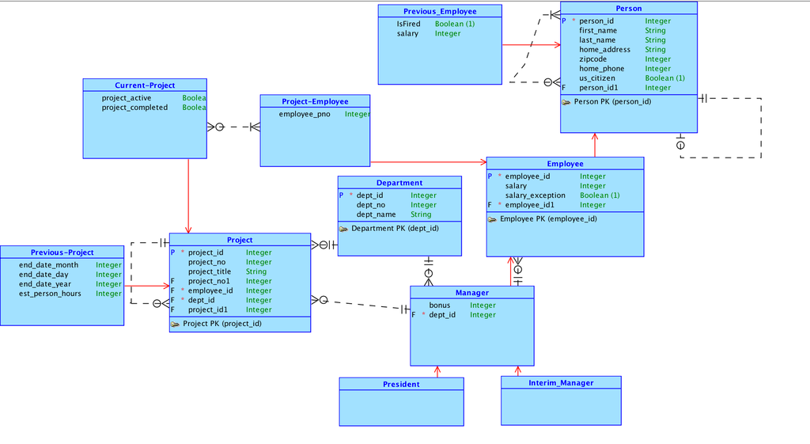
Conceptual Data Model

Slide 4
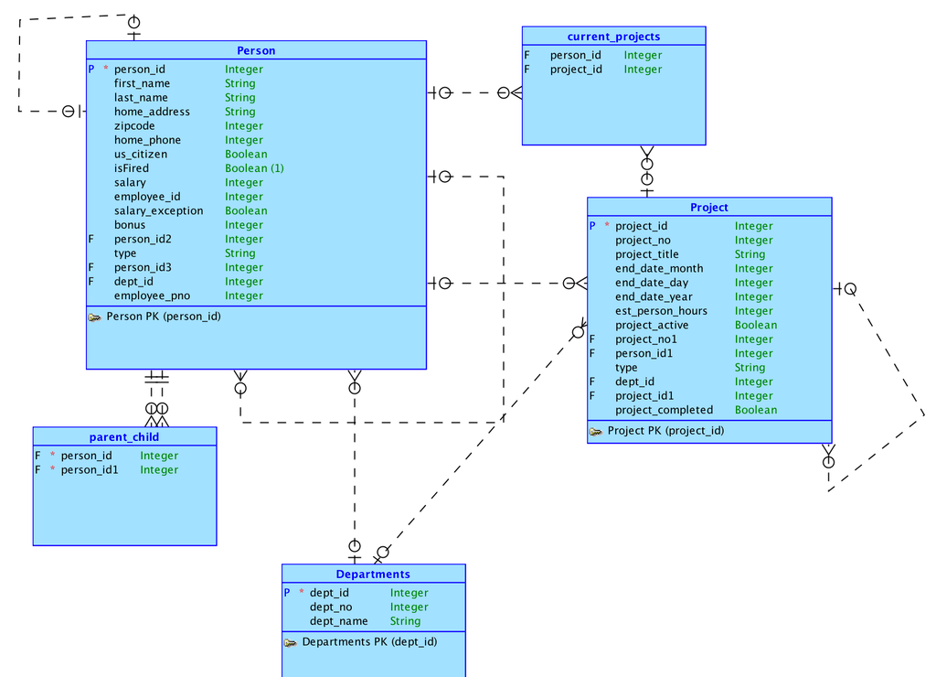
Logical Data Model

Slide 5
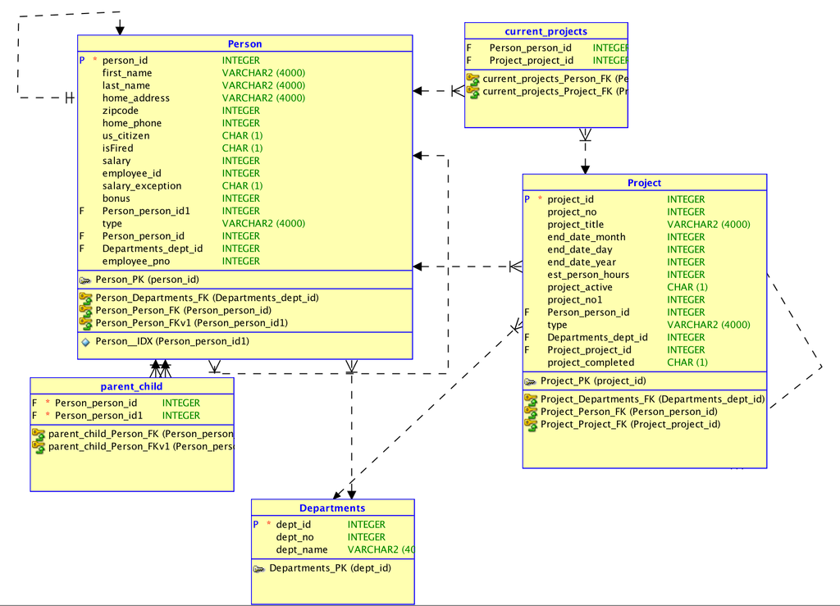
Relational Data Model

Slide 6
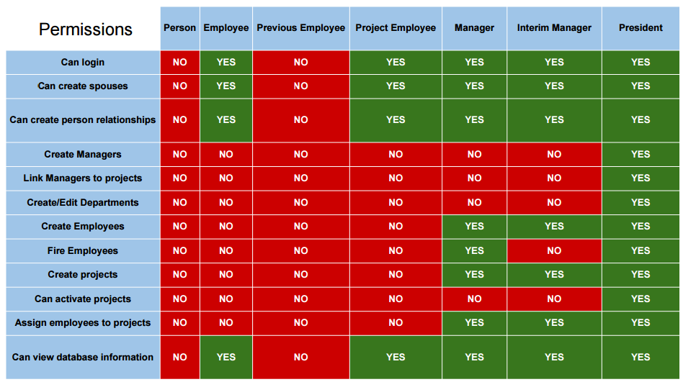
Credit goes to Caelan Evans, Akshay Kasukehla and Seth Milligan

Slide 8
Features
Login page
Dynamic access to pages based on user type when logged in
Form creation access based on user type
Dynamic forms
Dynamic page redirection after submitting a form
When adding a spouse, the spouse’s row will also update to list their spouse.
Functioning edit button with auto-fill
Multiple regions on one page

Slide 9
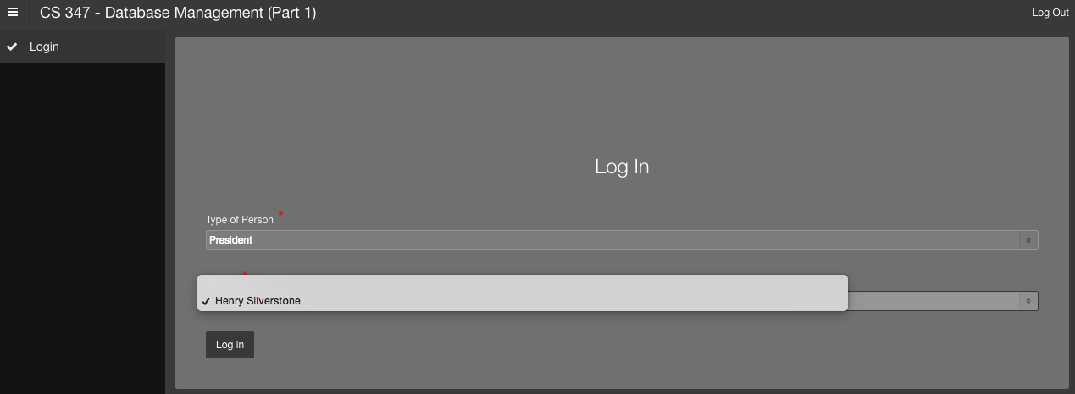
Apex Screenshots

Slide 10
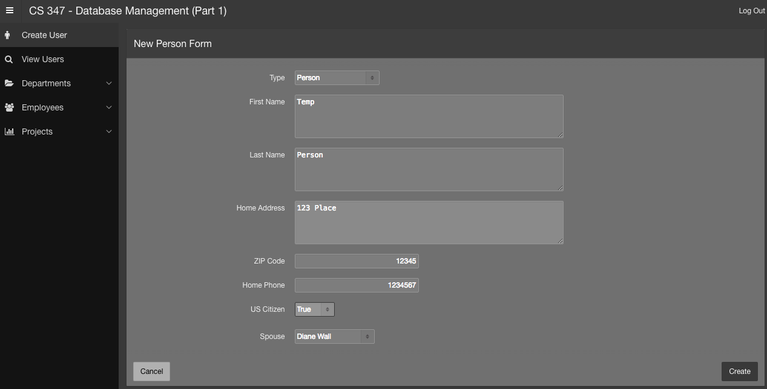
Apex Screenshots

Slide 11
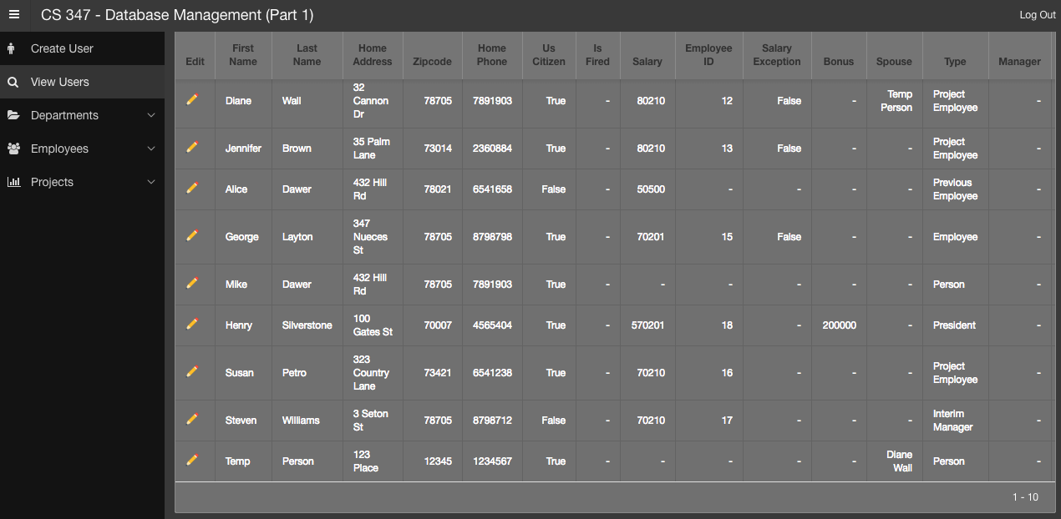
Apex Screenshots

Slide 12
Demo
https://apex.oracle.com/pls/apex/f?p=94424

Slide 13
Github
https://github.com/livicky11/S16E3.git

Slide 14
Part II

Slide 15
Conceptual Model

Slide 16
Apex Screenshots

Slide 17
Apex Screenshots

Slide 18
Apex Screenshots

Slide 19
Apex Screenshots

Slide 20
Relational vs. SIM
Object oriented vs. non-object oriented
Subclasses are automatically a type of superclass in SIM
Ex. A manager begin part of the manager and person table

Slide 21
Demo
https://apex.oracle.com/pls/apex/f?p=99123

Slide 22
Git Repository
https://github.com/livicky11/S16E3

Slide 23
Thanks!

